Slide 1
Working Experience of Himax
Rafael Lin
kwang997@gmail.com
0912768499

Slide 2
Outline
HiTouch Designer :
Programming FW and load configuration
Generate mapping table
Observe data and fine tune parameters dynamically
Register Read/Write
Bridge Board Introduction
Notes:
1. This is the outline of my presentation. At first, I will introduce the tool which I am in charge of at Himax company.
2. Secondly, besides the program running at PC, it is also my job to maintain the bridge board firmware. Since Himax Touch IC transfer data by I2C channel, one of the bridge board’s functionality is to receive data from I2C bus and transfer it through USB endpoint.

Slide 3
Overview
Hi Touch Designer
Load Config.
Edit Config.
Save Config.
Misc.
Program & Load configuration
IC & Channel Mapping
Register Editor
Instant Performance Fine Tune
Observer Raw Data & Performance
Save Configuration
Gesture Demo
Demo Panel
Notes:
There are 4 main functionality in the Hi Touch Designer.
It has the capability to program FW into its flash memory or load configuration into registers of the chip
I Could observe the capacity signal from the touch panel and see the reported coordinate on the computer screen
If the performance is not as we expected, we could use this tool to tune the corresponded parameter to improve its performance.
After several-times parameter-tuning, we could reserve all of the parameter into one FW for future usage.

Slide 4
Outline
HiTouch Designer :
Programming FW and load configuration
Generate mapping table
Observe data and fine tune parameters dynamically
Register Read/Write
Bridge Board Introduction

Slide 5
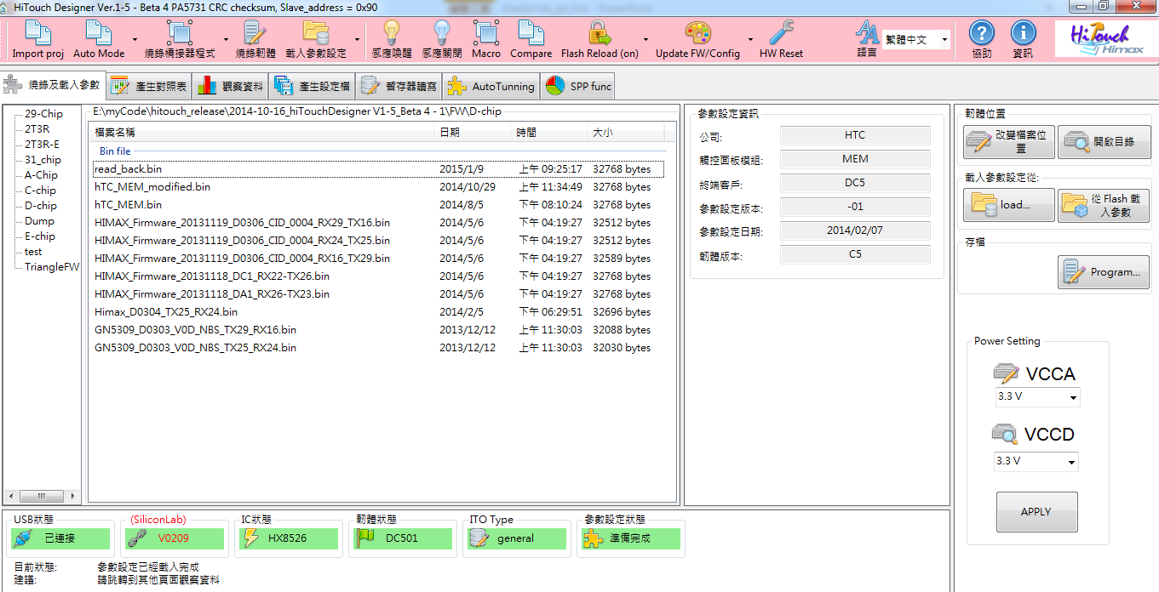
Program & Load FW
The outlook of Program & Load FW page
Voltage Setting
Connected Status
FW management
Loaded FW info
Notes:
This is the outlook of the hiTouch Designer. At the bottom shows the connected status
Connected status : If we connected the Touch IC into the computer, a series of initialization would be launched, such as bridge board FW checking, Touch IC FW version checking, and IC type recognition.
On the right-handed side was VCCA/VCCD setting panel .We could adjust the voltage of the digital and analog by click the combobox and then click the apply Button and the desired voltage would be set.
On the left-hand side is a FW management panel. In this tool, there is a directory called FW and there are many sub-folder which consists of many FW files. For example, there is a sub-folder called D-chip, and if we click this node. It will show every FW files of this sub-folder in the middle panel and they are all corresponding to the D-chip.
After the members of FW teams finish developing the FW, they will release the latest FW to me, so that I could compress it and the tool together and release the compressed file to the other FAE or colleagues.

Slide 6
Outline
HiTouch Designer :
Programming FW and load configuration
Intro. To Mapping func.
Observe data and fine tune parameters dynamically
Register Read/Write
Bridge Board Introduction

Slide 7
Channel Mapping
Hi Touch Designer
Load Config.
Edit Config.
Save Config.
Misc.
Program & Load configuration
IC & Channel Mapping
Register Editor
Instant Performance Fine Tune
Observer Raw Data & Performance
Save Configuration
Gesture Demo
Demonstration Panel
Notes:
在帶新案子的時候，第一步要做的事情就是 mapping，這個功能的用意是，把 TP 上的透明走線，對應到 IC 上的每一個 pin 腳。讓 IC 和 TP 相互認識。
首先，我們需要一個由 FW team release 的 FW，來進行操作。所以我們需要載入 FW. 在作完 Mapping 之後，再把新的暫存器的設定值放入匯出的 FW 之中。
Normally, The first thing to do when we have to promote new project is to do the channel mapping function. The purpose of the mapping function is to connect the pin assignment between touch panel and Touch IC.
As we know, there are many invisible channels on the touch panel. But Touch IC do not know how these channels connect to the output pins of the chip. Therefore we have to do the mapping function so the touch IC would know the relationship.

Slide 8
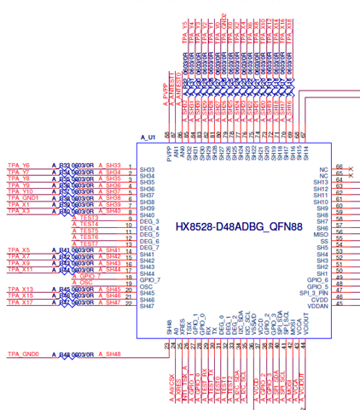
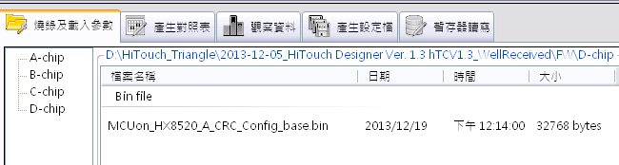
Intro to Mapping func.
Select a FW file to load config
Get a Schematic for pin to pin assignment
Notes:
Before we do the mapping function, there are two material we need to achieve our purpose
At first, we need one FW file as a container to reserve the mapping information.
Secondly, we need a circuit schematic to know the pin assignment between the chip and the panel. As in the photo, it indicated that the channel 33 is connected to Y6 on the Touch panel.
After we construct one mapping table by the schematic, we could transfer these information into a set of register setting and finally, put it in the container and exported it as another new FW file.

Slide 9
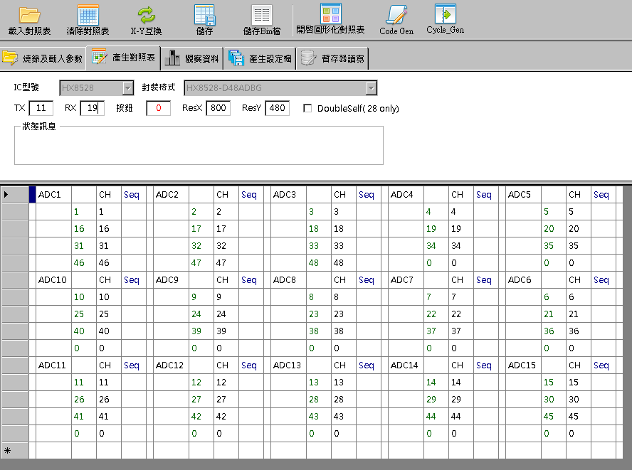
Intro to Mapping func.
1.
2.
3.
Select IC type and IC package
Fill the X, Y and Button numbers
Notes:
有了上述兩個材料之後，就可以進行下一步了。我們是以填完一個 excel 表的方式，來完成這個 mapping 的工作。在填完這個表之後，Tool 會把他們轉化成 register 的設定，最後存到 FW 的 configuration 裡。
After loading the FW, we could jump to another mapping page, fill the IC type and IC package and X number and Y number as the basic information. Traditionally, after user fill the excel form. The job is finished because the tool would transfer the excel form into a set of register setting.
So next we will introduce how to fill the form.
In this form, there are 15 ADC components which contains 4 channels. The task of each ADC component is to scan its channels for sensing the change of the electric capacity.

Slide 10
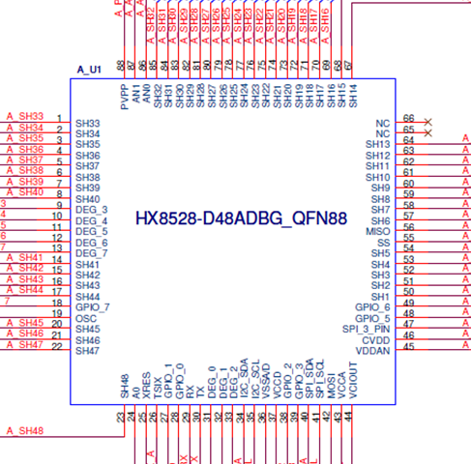
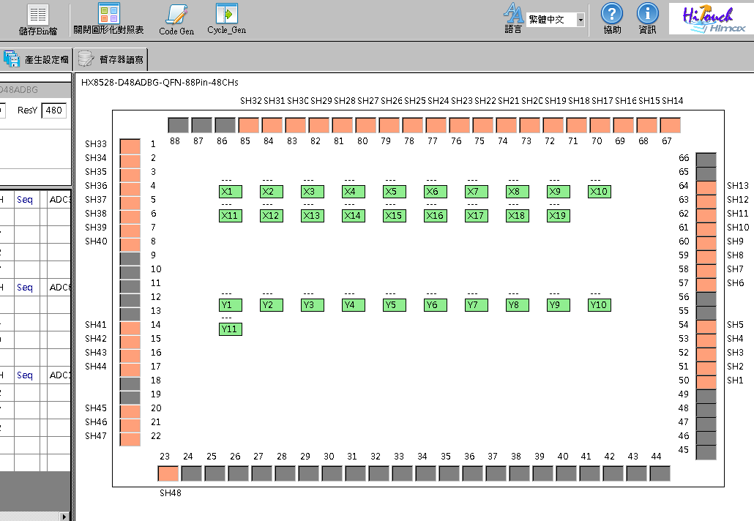
Intro to Mapping func.
Since it is very un-friendly to do the mapping, we design another quick method.
X Number
Y Number
For each different package, there is one specific class to construct the GUI package.
Notes:
Since it is very un-friendly to transfer the schematic information into the excel form, we have design another method to do this job in a more convenient way.
For each package, we write a class for corresponding with it. After click the GUI mapping button, another panel will jump up. This panel resemble to the schematic
Take this picture as an example, the package is HX8528-D48 QFN88. QFN 88 means that there are 88 pins on the chip. D48 means that there are 48 pins which are usable for channel mapping. The 48 pins could be connected to the invisible channels on the touch panel.
Therefore, there are black rectangle and orange rectangle on the edges of the panel. The orange ones means that they are suitable for channel mapping. Each of them could be connected to X or Y. As for the black ones, they have other special purpose so it could not connect to the invisible channels.
In addition, we previously enter the total number of X channel and Y channel, so after we click the button, the same number rectangle will show on the middle of the panel. If we let total X channel equal to 8 and total Y channel equal to 10. 8 rectangle will show in the middle of the panel to represent X channel and Y…

Slide 11
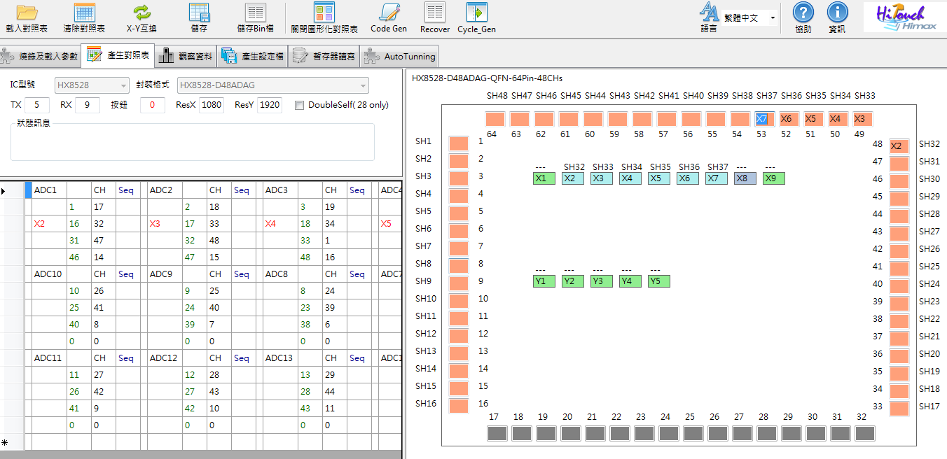
Intro to Mapping func.
According to the schematic, finish the pin assignment
Notes:
In this slide we will introduce how to use this GUI panel. According to the schematic, we can know how to fill it. For example, if Channel connect to X2, the only things we have to do is to click the X2 rectangle once and then click the Channel 32 rectangle. After that, the cell would be filled automatically.
Likewise, if we click X3 rectangle and channel 33 rectangle, this information will fill in the excel right away. We could treat the other channels in the same way and finish the pin assignment.

Slide 12
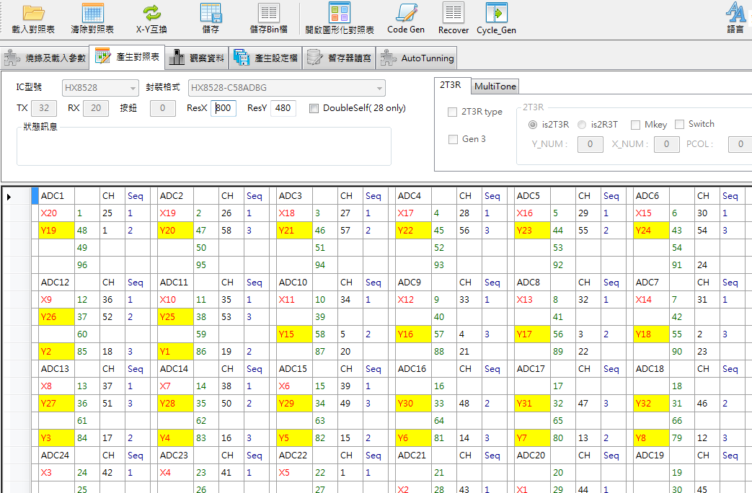
Intro.to Mapping func.
Transform Excel information into register setting :
Notes:
The next thing we need to do is to fill the cycle number. The ADC component need to know when to scan its own channel. There are four channels on each ADC and we need to let them know which channel to scan at each cycle.
Since the filled method is fixed, we have already build the filled method as a general function. If we click the button, the cycles number would be generated automatically.
In the end, the Excel form finally be filled and the rest of work would be finished by the tool. By click the “Save bin” button, the information of the excel form would transform into a series of register setting. And the tool would jump to another page for keeping other information.

Slide 13
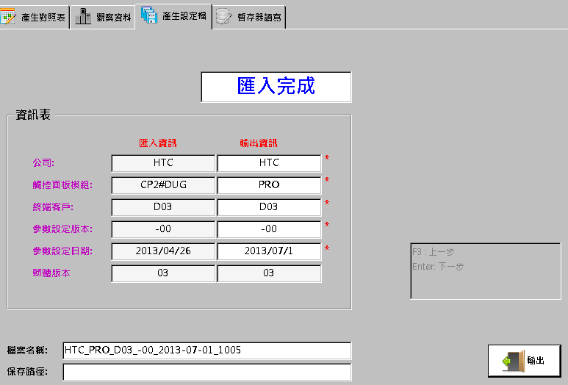
Intro.to Mapping func.
Generate a New Firmware
CFG
CFG
FW
FW
Notes:
It would jump to this page so that the user could filled the name of the smartphone company, the name of the touch panel module and the date of the final parameter modification.
Next we could click the button then save the mapping information into another FW and export it.
Specifically, in Himax touch firmware design. We allocate the configuration part at the top of the FW and the “Algorithm” part at the bottom of the FW.
The advantage is that we want to have isolate the configuration and algorithm part. In order to deal with different project, we only need to replace the configuration part and keep the “algorithm part” as same as the original firmware. It save a lot of time when we have to handle many project at the same time.

Slide 14
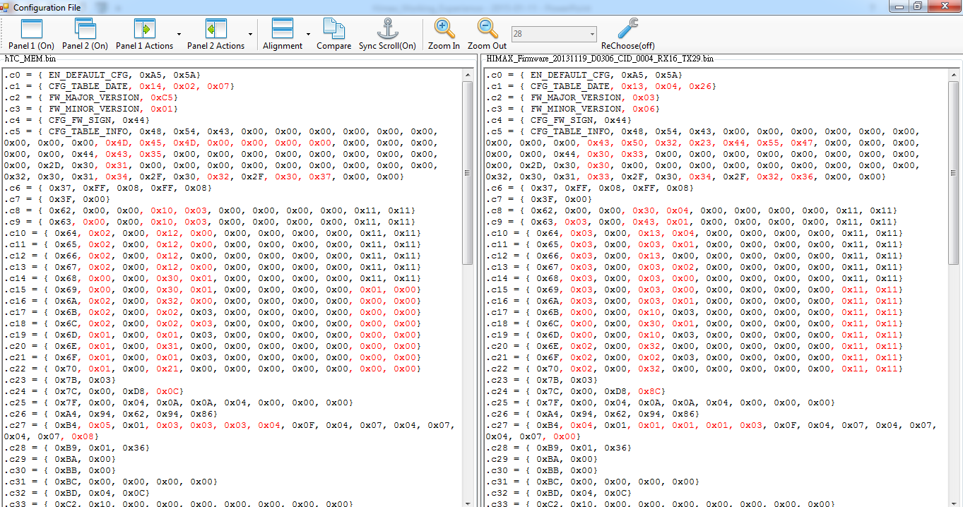
Intro to Mapping func.
Compare the difference of the exported bin file and original file.
Show the difference by the Red color
Register Address
Parameter Content
Notes:
In case that there are some error in the exported FW, we will compare the content of the configuration between the original FW and the exported FW.
And show the difference by the Red color so that the user could see the different parameter content easily.
After clicking the export button, the tool will automatically parse the configuration of the both FW. And show them as the picture indicated. For each line, the first column is the register address, and the rest of the other item is its parameters.

Slide 15
Outline
HiTouch Designer :
Programming FW and load configuration
Generate mapping table
Observe data and fine tune parameters dynamically
Register Read/Write
Bridge Board Introduction

Slide 16
Hi Touch Designer
Load Config.
Edit Config.
Save Config.
Misc.
Program & Load configuration
IC & Channel Mapping
Register Editor
Instant Performance Fine Tune
Observe Raw Data & Performance
Save Configuration
Gesture Demo
Deme Panel
Notes:
In the following, I want to introduce how to observe the raw data and coordinate data. After finish the mapping function, if we put one finger on the touch panel, we could see that the signal show on the screen and move in the same direction as the finger.
But we may have other problems and expect to improve its performance. For example, the line could be broken in the middle while we have our finger move along. This is because the finger signal is not big enough in the middle of its path. So the line is disconnected.
As for other problems, such as the report rate is too long and it can not meet the customer’s requirement.
Therefore, we have to tune several parameters in order to achieve a satisfied performance.

Slide 17
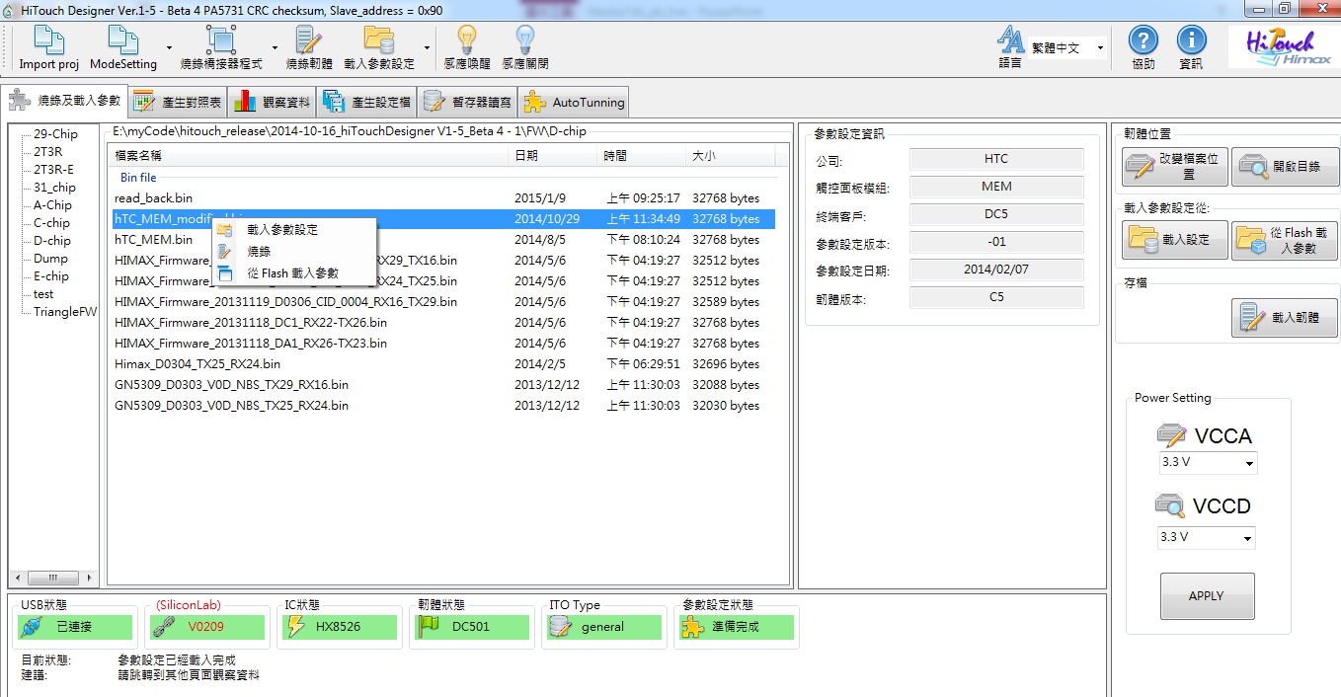
Intro to Data Observation
After finished mapping routine, we could try to program the configuration into the IC Flash
Right click to trigger the menu for FW loading & programming
Notes:
At first we need to load and program the above FW into the touch chip.

Slide 18
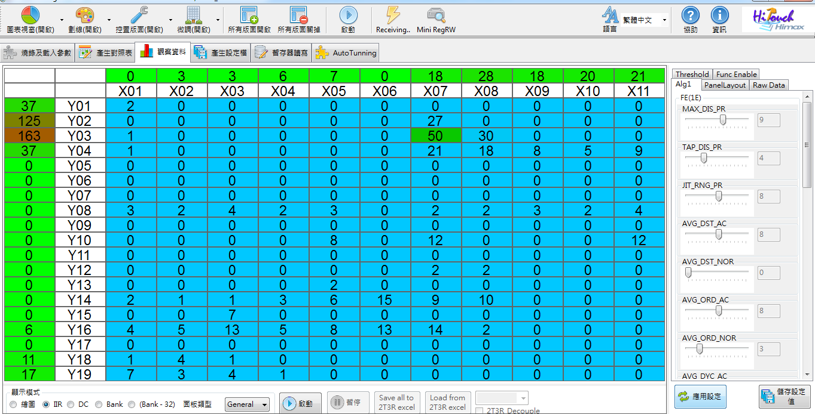
Intro to Data Observation
Data Observation
Fine Tune Panel
Notes:
Then we could jump to the observation page. On the left-handed side is the data observation panel. And on the right-haned side is the fine tune panel.

Slide 19
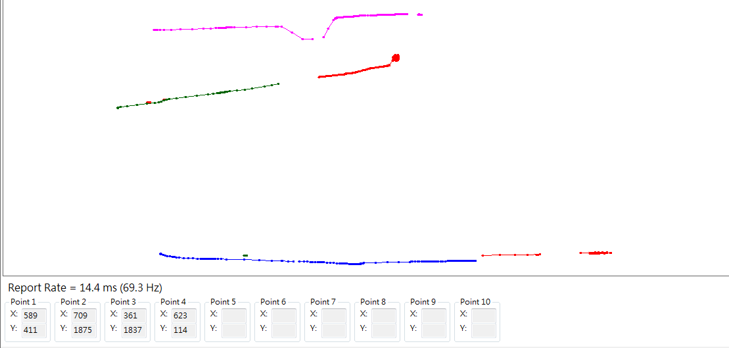
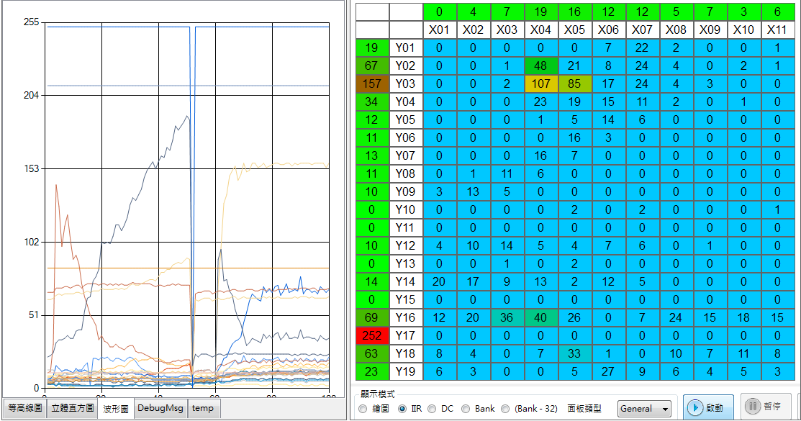
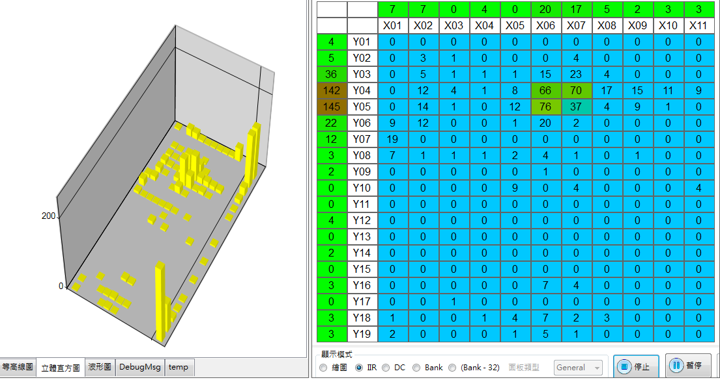
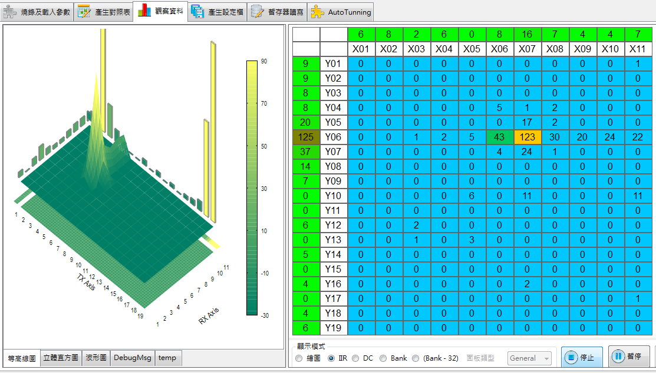
Intro to Data Observation
Draw Mode
Waveform View
3D Model View
Histogram View
Notes:
As for the observation panel, we have multiple way to present the capacity difference.
At first, the capacity difference shows as digital value and presented as a two-dimentional array.
Then, we could transform the digital values into the 3D model so that users could see the signal it in the different way.
We also could observe it in the histogram view and waveform view.
At last, since we are develop the touch firmware, its purpose is to report coordinate of the finger to the baseband. So we could treat the panel as a canvas and try to draw with our finger.
At the bottom, the report rate is indicated here and each X-Y tuple for each point is show at there.

Slide 20
Intro To Fine Tune
Step 1. Tune the specific item.
Step 3. Check its efficacy.
At Last, Save the parameter setting into bin file.
Step 2. Click the apply setting.
Notes:
再來是介紹參數微調的部份，我們會針對某些 item 的 performance 不滿意或是遇到問題，例如說…雜訊太大，手指訊號太少，劃線不夠直，劃線會斷線…等等 … 就必須找相對應的參數作調整。
這個時候，就來使用右手邊這個 panel 並找到相對應的參數，作調整，如果調完之後，那就再到下面按下 apply ，應用目前的設定值。看觀查剛剛遇到的問題有無改善。
這一個 item 調整到滿意之後，再換下一個進行調適，一直到整體表現都尚可滿意為止。
最後再把所有設定值都在存成另一個新的 FW 。有點像打RPG 遊戲一樣，最後進行存檔，以方便之後的調閱和調適。
We may have some performance problem while we try to use our finger moving on the panel. Such as, if we want to draw a straight line on the panel, but the line is not straight enough or it will be broken in the middle. In the moment, we have to tune some parameter to improve its performance.
For example, there is a test item called jitter on the machine test. The machine arm will keep punch the touch panel at the same point and see whether the IC will report the same X-Y coordinate or not. If the signal is not strong enough or is interfered by any noise, the touch IC would not report the same X-Y coordinate as the previous point. Then the test is won’t be passed. Therefore, the FW team have one workaround to solve the issue.
Which is they pull one parameter call “ tap distance range”. It means that if the distance between the current point and the previous point is less the “TAP DISTANCe RANGE”, the touch IC will still report the previous point in order to have the test pass.
After tuning the parameter and click the “ apply setting “ button, users could see the efficacy on the left panel. If test item is pass, the FASE will keep tuning other parameters until the overall performance is satisfied.
At the end, we could click the “save setting” button to reserve the above new parameter into another exported FW.

Slide 21
Intro. To Fine Tune
Generate a New Firmware
CFG
CFG
FW
FW
Notes:
Same as mapping function, the tool will jump to this page and let user to input other rest information. Then save the register setting into another exported FW.

Slide 22
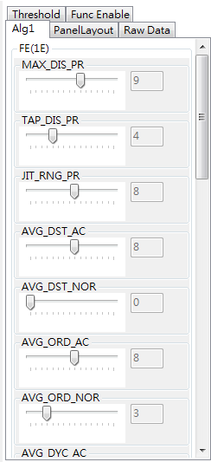
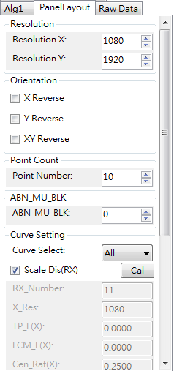
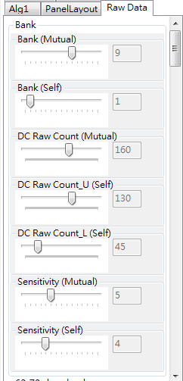
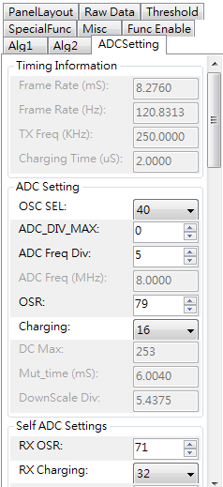
Intro. to Fine Tune
The fine tune item is diversified, so it is necessary to complete this function with more complicate data structure
Notes:
Specifically, it is quite difficult to maintain the fine tune function because the UI component is directly pull on the panel. Every time the FW change their parameter table, we have to use the mouse to add another UI component on the panel and re-compile the program.
This is a very bothering task to do since they are change their common firmware.
Therefore, we have a idea to dynamically generate this UI-item according one csv file. If FW team update their parameter table, we have no need to re-modify the program and rebuild it. The only thing we have to do is to modify the csv file for dynamically add or delete any fine tune item. In our design, each fine tune item is a class and it is constructed by one line data from the csv file for setting its value, UI type and
This idea is save us a lot of time and effort.
As the picture shows, there are a lot of different UI component on the panel, such as combox, checkbox, label and numericUpDown. Each of the fine tune item is a class and it represent one purpose and get its value from some bit range of one register, and finally show it by different UI component.

Slide 23
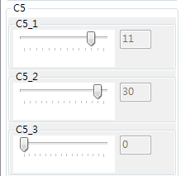
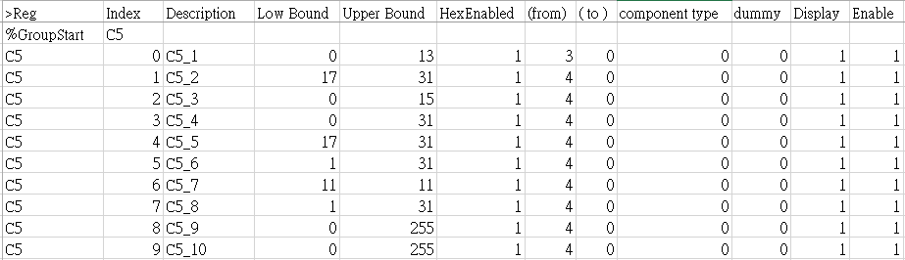
Intro. to Fine Tune
We use one csv file to construct each fine tune item
Each line present one fine-tune item.
Address
Name
Value Range
Bit range
Present type
Misc.
Notes:
Take The C five register group for example, the first two column indicates the register address. As we just say, each line present one fine tune item. So the first fine tune item would get its value from the first parameter of C five register.
Secondly, the third column shows the description which would show on the panel.
The next two column are the low bound and upper bound of this item, which also would set the boundary on the UI component.
Since not all of the fine tune items are get their value from the 8 bits of the parameters, we also could set the valid bit range in the next two column
Then the UI present type show on the next column.
We could decide whether to display the item or whether to enable it or not by set the last two column.

Slide 24
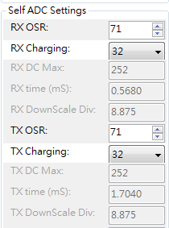
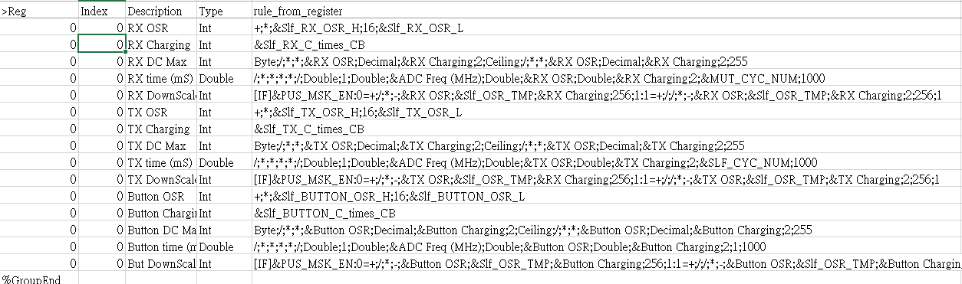
Intro. To Fine Tune
We use one csv file to construct each fine tune item
Each line present one fine-tune item.
+;*;&Slf_RX_OSR_H;16;&Slf_RX_OSR_L
= Slf_RX_OSR_H * 16 + Slf_RX_OSR_L
&Slf_RX_OSR_H^/;&RX OSR;16|&Slf_RX_OSR_L^%;&RX OSR;16
→ Slf_RX_OSR_H = RX OSR / 16
→ Slf_RX_OSR_L = RX OSR % 16
After adjusting the compound parameter, we have to parse it into corresponding register.
Notes:
For some fine tune items, their value is not directly retrieved from one parameter. It may get its value from a complicate formula. Therefore, we have to record the rules of its method.
For example, the RX OSR fine tune item equal to the Slf_RX_OSR_H * 16 plus Slf_RX_OSR_L. So we write the formula on this cell. In order to let parse operation be more easy, we move the operator before the operand.
Now we know how to get the value of RX OSR. But when this item’s value is change, for example, the value is changed from 71 to 80, we also have to know which register is affected by it and change them immediately.
So we write another rules to record the above information. Similar to the previous method, we write the second rule next to above cell. For example, the rules shows like this. And after Tools parsing process, it means that Self RX OSR_H equals to RX OSR divide 16 and Slf RX OSR L equal to RX OSR mod 16

Slide 25
Outline
HiTouch Designer :
Programming FW and load configuration
Generate mapping table
Observe data and fine tune parameters dynamically
Register Read/Write
Bridge Board Introduction
Notes:
In the next, I wanna introduce the register read/write function

Slide 26
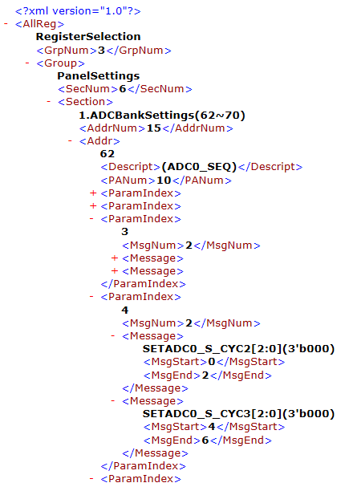
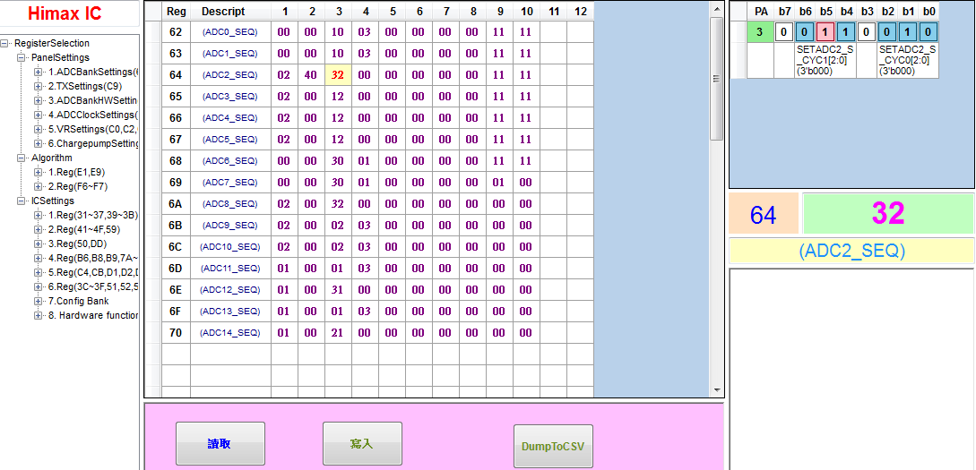
Intro to Register Editor
Register Editor tab page :
Show the bit representation.
After modification, click the button to do register write
Do MassRead of the group
Grouping register cluster, based on the XML file
After IC type is identified, XML content will be read
Notes:
When the New Chip is released, the RD would release one Excel file in which explain there are some improvement function which is control by the new register. So
It is necessary to transform the excel file into one readable format. So the user could know the purpose of each item.
After the IC type is identified, the HiTouch Designer would automatically load the related XML file and parse its content.
For one particular chip, we mainly divide its registers into three section and each section contains many group, which has a lot of registers of the similar usage.
If we click the node of this section, hiTouch Designer would do mass register read operation and show the content at the middle panel. If we click the specific cell, that’s say, the third parameter of the register 0x Six Three, the binary presentation would show at the right-hand panel, and the annotate/note of each item is shown below.
The UI component is button, and if we click the zero button, it would transfer its value to one and vice versa. After we click it, the value of this parameter would change immediately.
If we finish edit the register we could set the register’s value by clicking the write button.

Slide 27
Outline
HiTouch Designer :
Programming FW and load configuration
Generate mapping table
Observe data and fine tune parameters dynamically
Register Read/Write
Bridge Board Introduction

Slide 28
Intro. To Bridge Board
Bridge board :
Cypress FX2 as the first generation bridge board and SiliconLab Bridge board as the 2nd gen bridge board (HID protocol)
Setting VCCA & VCCD by DAC and setting hardware pin (power on/off, reset )
Polling command from PC and launch them through I2C Bus
Receive I2C data from Touch IC by TSIX pin
Notes:
Besides the hiTouch Tool, I was also in charge of the bridge board firmware development, whose main function is to transfer USB packet into I2C data for communication with Touch IC. Besides, it is necessary to enter interrupt service routine when chip’s coordinate data is ready, otherwise, the coordinate could not transfer to Computer.
At last, the bridge board has the capability to control the power on, power off and reset bin and the analog and digital voltage.
For the convenience of the customer, we modify the descriptor table so that the device would be regarded as one hid device. Customers could use this device without install any extra software.

Slide 29
Q&A

